Slide 1

bethesda.afceachapters.org
2023-2024
AFCEA Bethesda
Case Study Competition
Health IT Summit| January 2024

Slide 2
AI-Expedited ASPR Grants
Joshua Chambers, Pooja Jakkampudi, Antonia Meier, Elijah Muzzi, Esha Vaidya
Health IT Summit| January 2024
Notes:
Esha
Hello everyone, my name is Esha Vaidya, (everyone introduce themselves). And we all, along with one of our teammates at home, Joshua Chambers, came up with a plan to expedite grants given by the Administration for Strategic Preparedness and Response, or ASPR, using artificial intelligence, AI.
We will start off with a brief introduction of ASPR, then move on to identifying the key issue with ASPR grants. We will follow up with an explanation of our solution to the issue and the short and long term impacts of our solution, and we will end with a timeline of how we would implement our solution.

Slide 3
Administration for Strategic Preparedness and Response (ASPR)
What is ASPR?
Prepare …
Respond …
Recover …
for medical & health emergencies (natural/manmade)
Notes:
DELETE SLIDE??
Pooja

Slide 4
Problem Statement
One third of states in the US believe that ASPR grants arrive too late during public health emergencies.
Notes:
Antonia
1/3 of states think that grants are disbursed too late and can be hard to apply for in a public health emergency (Homeland Security Agency)
- these states also think that the process for applying for grants can be quite involved, especially in the midst of emergency
Agency Fincial Reprots – impact of federal programs

Slide 5
Current Grant Process
Approach
Organizational Capacity
Budget
Work Plan
Project Relevance & Evaluation
Funding Priorities
Qualification for Funding Preference
Notes:
Pooja

Slide 6
Solution
Proposal Selection
Proactive Initiation of Grant Process
Proposal Generation
Custom fine-tuned UmlsBERT
Incorporation of AI into NSSP
Develop GenAI and engineer general prompt
Classify grants based on impact
Increasing database of NSSP
Retraining grant writer
Retraining grant manager to review proposals and validate classifications
Generate proposal template
Training grant manager to monitor
Wait until technology enables a cheap creation of secure LLM
Development of relief fund
Notes:
Elijah

Slide 7
BERT Introduction
Existing Model - Bidirectional Encoder Representations from Transformers
ClinicalBERT
A Natural Language Processor
Self-Attention Mechanism
Masked language model
Case Study (2020)
Conference on Health, Inference, and Learning
Predicting Hospital Readmission
Notes:
Antonia
Using NLP form proposal generation
Finding relevant past research
Creating possible predictions
rained using medical data and literature

Slide 8
Proposal Selection
Goal: Determine which grants are "High Impact"
Using Gen AI, develop interface to expand given engineered prompt to generate a grant proposal
Inputs:
SVM/LDA classifier outputs used for topic modeling
Necessary specifics from hospital (funding, timing, etc)
Relevant Medical data
Using prompt engineering tools shape Gen AI generated proposal
Human working in tangent with AI to review and edit proposal
Hospital given choice to expedite proposal writing process with AI or proceed without
Notes:
Eli

Slide 9
Proposal Selection
Goal: Determine which grants are "High Impact"
Using a custom fine-tuned model based on UmlsBERT (Unified Medical Language System)
Improved contextual embedding to classify high impact grants.
Semi-supervised learning
Notes:
Eli

Slide 10
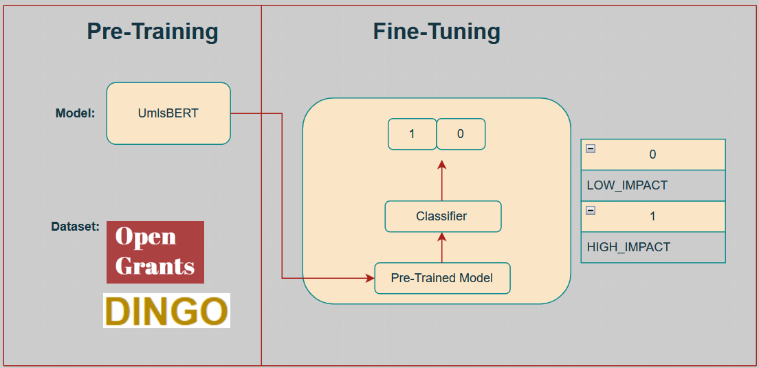
Proposal Selection
Notes:
Eli

Slide 11
Proactive Initiation of Grant Process
Physicians as sensors; National Syndromic Surveillance Program (NSSP)
Processing of symptoms/markers against database of existing symptoms/markers linked to certain diseases using a deep learning classifier
Alarm raised by NSSP and monitored by grant manager
Immediate dispersal of relief fund
Notes:
Esha – bold key words
- So one of the longer term solutions we would like to focus on is the proactive initiation of the grant process.
- Oftentimes, grants are applied for when an emergency is already underway – we wanted to shift the paradigm of preparedness and response to to be proactive rather than reactive
- Instead of just having tertiary institutes (i.e. big health systems/teaching hospitals) apply for grants when an emergency has been declared, have grant managers continuously monitor the healthcare ecosystem for POTENTIAL emergencies before they have occurred
- The way this could be possible is by using the National Syndromic Surveillance Program developed by the Centers for Disease Control (CDC). The NSSP is a database where emergency departments enter information about their patients’ conditions, including any symptoms they have.
- instead of just having Eds enter information, we could have every physician enter information into this database – that way, the physicians act as sensors for different symptoms and markers.
- Then, a deep learning classifier could be incorporated into the NSSP, where it processes the symptoms and blood markers (if blood test is run), against data already existing within the system and link certain markers and symptoms to diseases based on past data
- the system would then raise an alarm for a potential outbreak or emergency – physician would check these symptoms and diagnoses to confirm cause for alarm
- grant manager could be monitoring these alarms, and as soon as one is raised, they would immediately disburse a small relief fund to contain the situation after checking to make sure the situation calls for a relief fund
- this is the ideal situation – catch potential situations before they even get to the level of an emergency

Slide 12
Proposal Generation
Goal: Speed up grant proposal process
Use GenAI to create a proposal template based off an engineered promt
Initial problem data/info
GenAI
Proposal
Notes:
Antonia
Using NLP form proposal generation
Finding relevant past research
Creating possible predictions
rained using medical data and literature

Slide 13
Timeline
Proposal Selection
Proactive Initiation of Grant Process
Proposal Generation
Today
100 Days
1 Year
5+ Years
Notes:
Elijah
- proposal generation – costly and time consuming to make own secure AI
- proposal selection – all tech already available
- proactive initiation we have tech but it will take some time to set up the database and configure the deep learning classifier to NSSP

Slide 14
Short- and Long-Term Impacts
Short-Term
Impact Classifier
Long-Term
Expanding database
AI assisted grant request process
Relief fund
Catch & contain outbreaks quickly
Begin research early
Goal: expedite grants for public health emergencies
Notes:
Pooja
Short term:
Premade grants
sprint for quick turn around : proposal and clinical bert
Long term
Expanding the database
As time passes model will learn more
Further develop premade grant

Slide 15
Thank you!
Health IT Summit| January 2024
Notes:
- overall, we identified the issue of having grants arriving too late in the midst of public health emergencies, provided three-step solution to the issue, both including a short term sprint with proposal selection, and longer term solutions with proposal generation and proactive initiation, all followed by the impacts of these soutions.
Thank you so much for your time. Are there any questions?

Slide 16
References
Centers for Disease Control and Prevention. (2023a, September 20). Overview. Centers for Disease Control and Prevention. https://www.cdc.gov/nssp/overview.html#:~:text=By%20tracking%20symptoms%20of%20patients,whether%20a%20response%20is%20warranted.
Centers for Disease Control and Prevention. (2023b, September 20). Overview. Centers for Disease Control and Prevention. https://www.cdc.gov/nssp/overview.html
Devlin, J., Chang, M.-W., Lee, K., & Toutanova, K. (2019, May 24). Bert: Pre-training of deep bidirectional Transformers for language understanding. arXiv.org. https://arxiv.org/abs/1810.04805
Fhirfly. (2023, July 5). Transforming healthcare: Clinicalbert and UMLSBERT’s role in predicting medical codes from... Medium. https://medium.com/@fhirfly/transforming-healthcare-clinicalbert-and-umlsberts-role-in-predicting-medical-codes-from-a6321515d443
Grants management. Grants.gov. (n.d.). https://www.grants.gov/learn-grants/grant-careers/grants-management.html
Henning, K. J. (2004, September 24). Overview of syndromic surveillance what is syndromic surveillance?. Centers for Disease Control and Prevention. https://www.cdc.gov/mmwr/preview/mmwrhtml/su5301a3.htm
Hospital Preparedness Program (HPP). Use of hospital preparedness program funds. (n.d.). https://aspr.hhs.gov/HealthCareReadiness/HPP/Pages/Use-of-Hospital-Preparedness-Program-Funds.aspx
Imasogie, N. (2023, January 17). Clinicalbert: Using deep learning transformer model to predict hospital readmission. Medium. https://medium.com/nwamaka-imasogie/clinicalbert-using-deep-learning-transformer-model-to-predict-hospital-readmission-c82ff0e4bb03
kexinhuang12345. (n.d.). KEXINHUANG12345/Clinicalbert: Clinicalbert: Modeling clinical notes and predicting hospital readmission (chil 2020 workshop). GitHub. https://github.com/kexinhuang12345/clinicalBERT
Lutkevich, B. (2020, January 27). What is Bert (language model) and how does it work?. Enterprise AI. https://www.techtarget.com/searchenterpriseai/definition/BERT-language-model#:~:text=BERT%2C%20which%20stands%20for%20Bidirectional,calculated%20based%20upon%20their%20connection.
MSc., D. A. (2023, March 6). Maximizing the potential of latent Dirichlet allocation in natural language processing for topic modelling. LinkedIn. https://www.linkedin.com/pulse/maximizing-potential-latent-dirichlet-allocation-david-adamson-mbcs/
Muller, B. (2022, March 2). Bert 101 - state of the art NLP model explained. BERT 101 - State Of The Art NLP Model Explained. https://huggingface.co/blog/bert-101
Regional Disaster Health Response System. Criteria. (n.d.). https://aspr.hhs.gov/RDHRS/Pages/criteria.aspx

